Slide 1
Learning Objective
I will be able to solve applications involving exponential functions
Success Criteria
At the end of the lesson, I will be able to:
examine practical contexts that rely on exponential growth and decay models, including finance, population and temperatures.
use the ClassPad to solve, graph and analyse exponential growth and decay models.

Slide 2
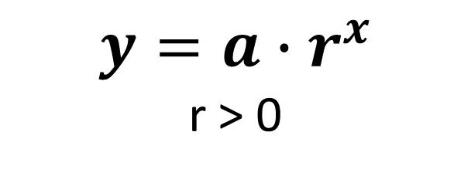

Generalised equation
Concept Development
$$y=a{∙r}^{x}$$
r > 0
$a$ is the initial value of $y$ (i.e. the $y$-intercept where $x$ = 0)
$x$ is the independent variable
$r$ is a multiplying constant aka common ratio

Slide 3

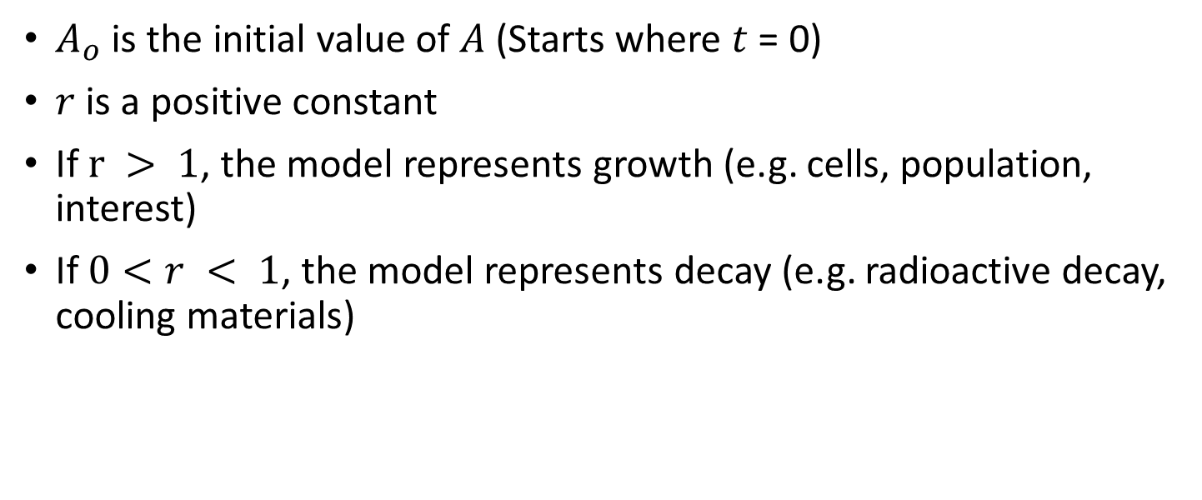
Exponential Growth and Decay
Concept Development
$$A=A_{0}r^{t}$$
$A_{o}$ is the initial value of $A$ (Starts where $t$ = 0)
$r$ is a positive constant
If $r > 1$, the model represents growth (e.g. cells, population, interest)
If $0<r < 1$, the model represents decay (e.g. radioactive decay, cooling materials)

Slide 4
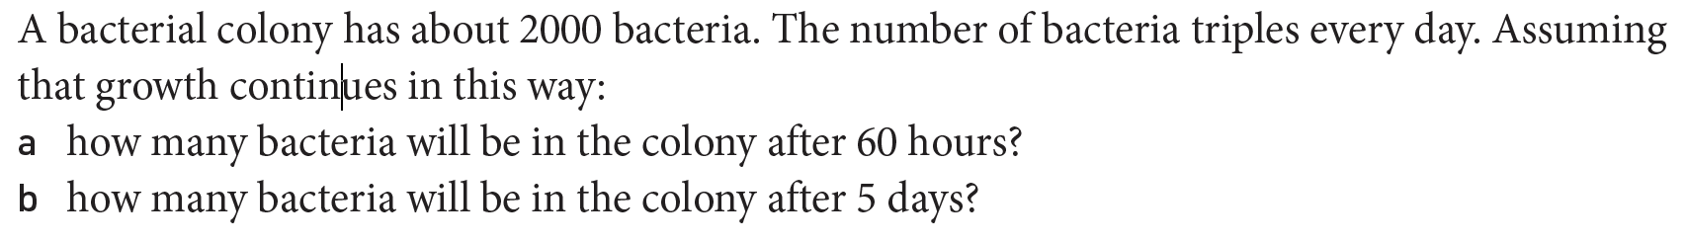








Guided Practice
Let $A=$ amount of bacteria
Let $t=$ number of days
Common ratio = 3 (because number of bacteria triples everyday)
$$∴A=A_{0}∙r^{t}$$
$$A=2000∙3^{t}$$
a) How many days is 60 hours? $\frac{60}{24}=2.5 days$
$$A=2000∙3^{2.5}$$
$$A=31 176.91 ≈31 177$$
There will be approximately $31 200$ bacteria after 60 hours
b) $A=2000∙3^{5}=486 000$
There will be approximately $486 000$bacteria after 5 days

Slide 5
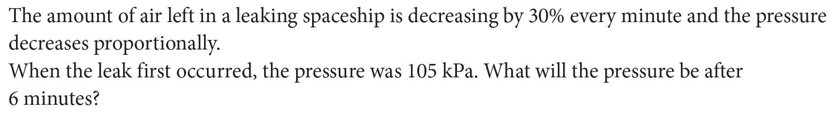







Guided Practice
Let $p=$ pressure in the spaceship
Let $t=$ number of minutes
Decay factor = $0.7$
Initial value = $105 kPa$
$p=105∙{0.7}^{t}$
When t = 6, $p=105∙{0.7}^{6}$
$$=12.35$$
The pressure after 6 minutes will be $=12.35 kPa$

Slide 6

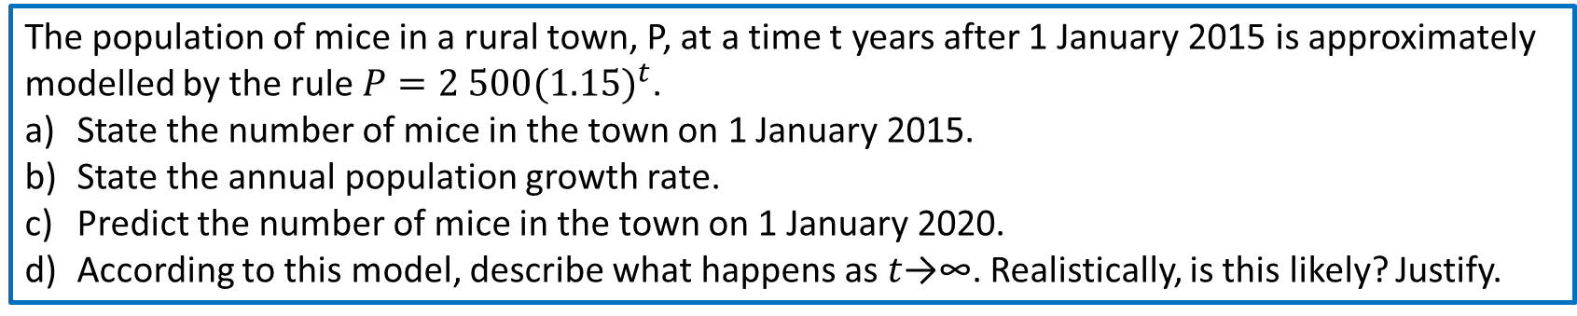



Guided Practice
The population of mice in a rural town, P, at a time t years after 1 January 2015 is approximately modelled by the rule $P=2 500(1.15)^{t}$.
State the number of mice in the town on 1 January 2015.
State the annual population growth rate.
Predict the number of mice in the town on 1 January 2020.
According to this model, describe what happens as $t$→∞. Realistically, is this likely? Justify.
a) $2500$
b) $15\%$
c) Number of years from 2015 to 2020 = 5 years
$$P=2500 {\left(1.15\right)}^{5}=5028. 39$$
There will be approximately $5030$ mice
d) The number of mice will approach $∞.$This is unlikely because there may not be enough food to sustain the
Mice population. Humans may eradicate the mice. The mice has a lifespan as well.

Slide 7
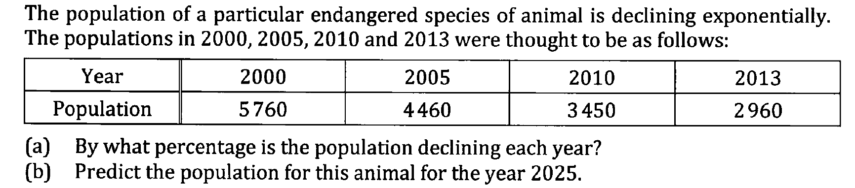







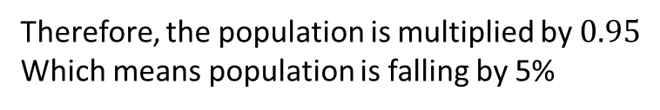




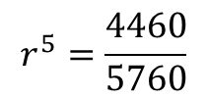


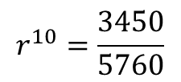
Guided Practice
Let $p=$ population
Let $t=$ number of years
b) $P_{25}=5760∙{0.95}^{25}$
Let $r=$ decay factor
$$≈1600$$
a) $Initial value=5760$
Therefore, the population for this animal is approximately 1600
$$P_{t}=5760∙r^{t}$$
$$P_{5}=4460$$
$$P_{10}=3450$$
$$4460=5760∙r^{5}$$
$$3450=5760∙r^{10}$$
$$r^{5}=\frac{4460}{5760}$$
$$r^{10}=\frac{3450}{5760}$$
$$r≈0.95$$
$$r≈0.95$$
Therefore, the population is multiplied by $0.95$
Which means population is falling by 5%

Slide 8
Independent Practice
Complete Exponential Application Worksheet

